Slide 1
HTML & CSS

Slide 2
What is HTML
Way to tag text files for the web so that the web renders the text in the desired way
Tells the page how to organize and format a page
Instructions for what goes where

Slide 3
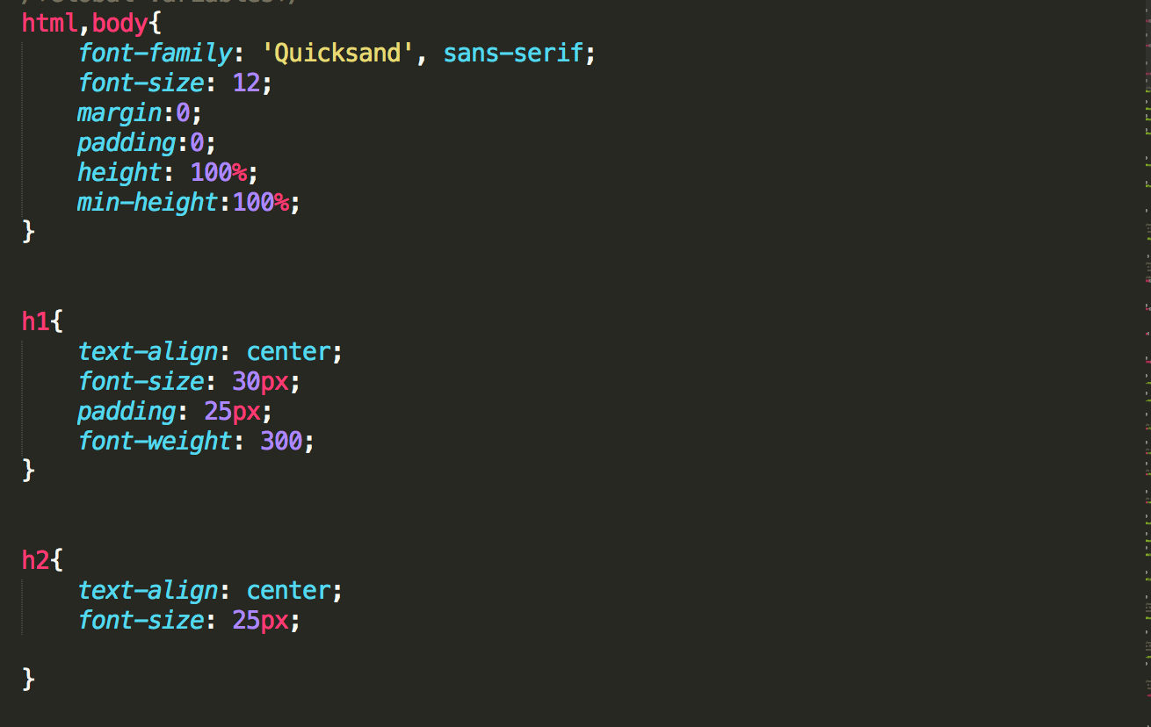
CSS
CSS is a helper file that styles the elements
gives color, size, and other attributes

Slide 4
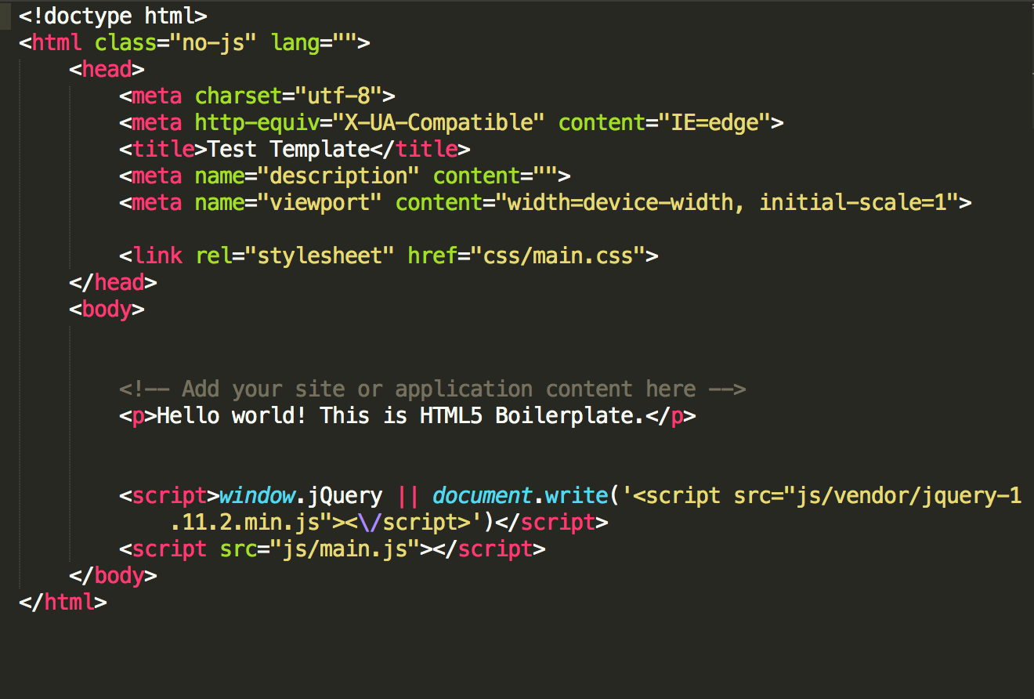
HTML
HTML is made up of tags : <> </>

Slide 5
Text Tags
<p></p>
Creates a new paragraph
<h1> </h1> --> <h6> </h6>
Creates headlines -- H1=largest, H6=smallest Creates an HTML document
<br>
Inserts a line break, like enter on the keyboard

Slide 6
Links
<a href="URL">clickable text</a>
adds a link to text between tag
Images
<img src="URL" />
Adds image; it is a separate file located at the URL or path

Slide 7
CSS
CSS gives color, size, other attributes
Styles are applied to specific elements in HTML
ex. h1, body, p

Slide 8



CSS Style
h1{
text-align: center;
font-size: 30px;
padding: 25px;
font-weight: 300;
}
Selector
Value
Property

